Slide 1
Maximising Network Flow Problem
Presentation By-
Shreya Sharma
Gauri Gupta

Slide 2
Main Aim – To reach the execution time of < 40 us for calculating maximum flow in a grid graph of 640X480 dimension.

Slide 3
Progress till now –
We have worked on the existing algorithms of network flows and improved their implemtation to achieve better running time.

Slide 4
Network Flow Problem
A type of network optimization problem
Given : A directed graph t = (V, E), where each edge e is associated with its capacity c(e) > 0. Two special nodes source s and sink t are given (s ƒ= t)
Problem: Maximize the total amount of flow from s to t
subject to two constraints
Flow on edge e doesn’t exceed c(e)
For every node v ƒ= s, t, incoming flow is equal to outgoing flow

Slide 5
Max-flow min-cut theorem
It states that in a flow network, the maximum amount of flow passing from the source to the sink is equal to the total weight of the edges in the minimum cut, i.e. the smallest total weight of the edges which if removed would disconnect the source from the sink.
Theorem: (maximum flow) = (minimum cut)

Slide 6
Minimum Cut
We remove some edges from the graph such that after removing the edges, there is no path from source to sink
The cost of removing e is equal to its capacity c(e)
The minimum cut possible is equal to the maximum flow through the graph.

Slide 7
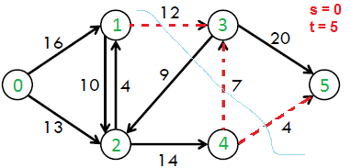
An example of Min Cut -
(red edges are removed)
Cost of min cut = 12+7+4
= 23

Slide 8
Max Flow = 11+1+7+4 = 23 = Min Cut

Slide 9
Some Well Known Algorithms for Maximum Flow

Slide 10
Ford-Fulkerson Algorithm
Main idea: find valid flow paths until there is none left, and add them up
How do we know if this gives a maximum flow?
– Proof sketch: Suppose not. Take a maximum flow f ⋆ and “subtract” our flow f . It is a valid flow of positive total flow. By the flow decomposition, it can be decomposed into flow paths and circulations. These flow paths must have been found by Ford-Fulkerson. Contradiction.

Slide 11
Back Edges
We don’t need to maintain the amount of flow on each edge but work with capacity values directly
If f amount of flow goes through u → v, then:
Decrease c(u → v) by f
Increase c(v → u) by f
Why do we need to do this?
Sending flow to both directions is equivalent to canceling flow

Slide 12
Ford-Fulkerson Pseudocode
Set f_{total} = 0
Repeat until there is no path from s to t:
Run DFS from s to find a flow path to t
Let f be the minimum capacity value on the path
Add f to f_{total}
For each edge u → v on the path:
Decrease c(u → v) by f
Increase c(v → u) by f

Slide 13
Analysis
Assumption: capacities are integer-valued
Finding a flow path takes Θ(n + m) time
We send at least 1 unit of flow through the path
If the max-flow is f ⋆, the time complexity is O((n + m)f ⋆)
“Bad” in that it depends on the output of the algorithm
Nonetheless, easy to code and works well in practice

Slide 14
Edmonds-Karp algorithm
Take shortest path (in terms of number of edges) as an augmenting path – Edmonds-Karp algorithm
How do we find such a shortest path? Running time O(VE²), because the number of augmentations is O(VE)
To prove this we need to prove that:
The length of the shortest path does not decrease
Each edge can become critical at most ~ V/2 times. Edge (u,v) on an augmenting path p is critical if it has the minimum residual capacity in the path:
c_{f}(u,v) = c_{f}(p)

Slide 15
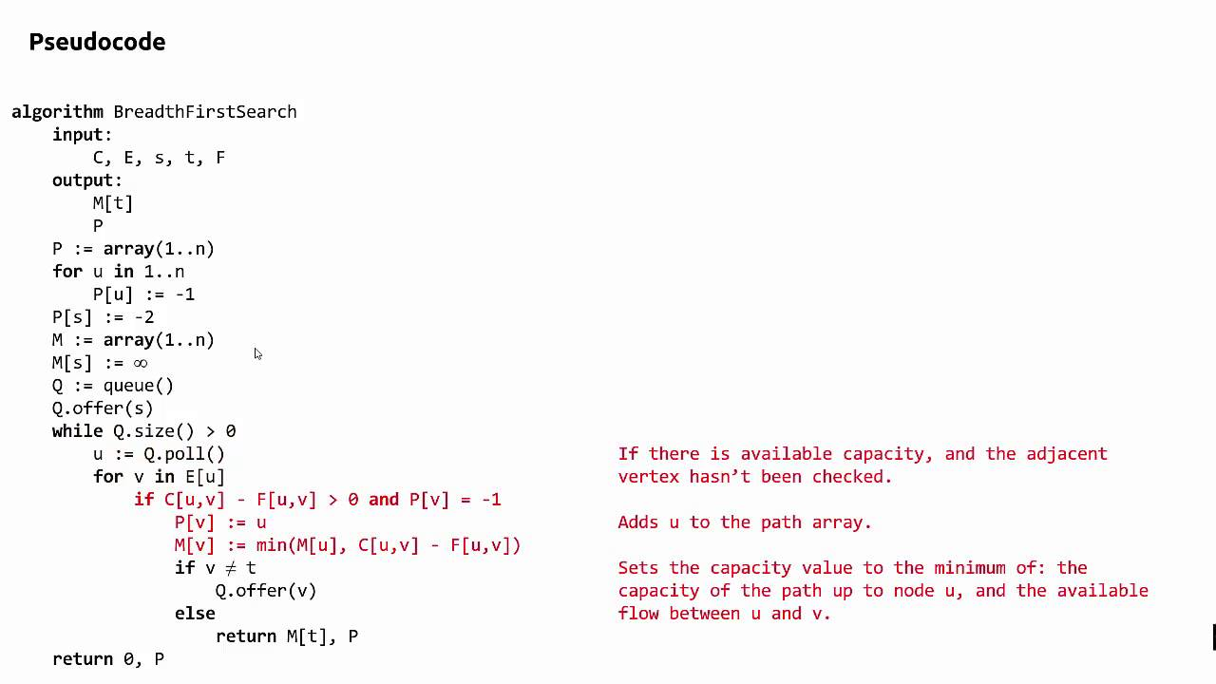

Slide 16
Non-decreasing shortest paths
Why does the length of a shortest path from s to any v does not decrease?
Observation: Augmentation may add some edges to residual network or remove some.
Removed edges obviously only increase the length of the shortest path
Only the added edges (“shortcuts”) may potentially decrease the length of a shortest path.
Where do these edges are added?
Opposite to some edge on the augmenting path, which is the shortest path!

Slide 17
Analysis
Why each edge can become critical at most ~V/2 times?
Scenario for edge (u,v):
Critical the first time: (u,v) on an augmenting path
Disappears from the network
Reappears on the network: (v,u) has to be on an augmenting path
We can show that in-between these events the distance from s to u increased by at least 2.
This can happen at most V/2 times
We have proved that the running time of Edmonds-Karp is O(VE²).

Slide 18
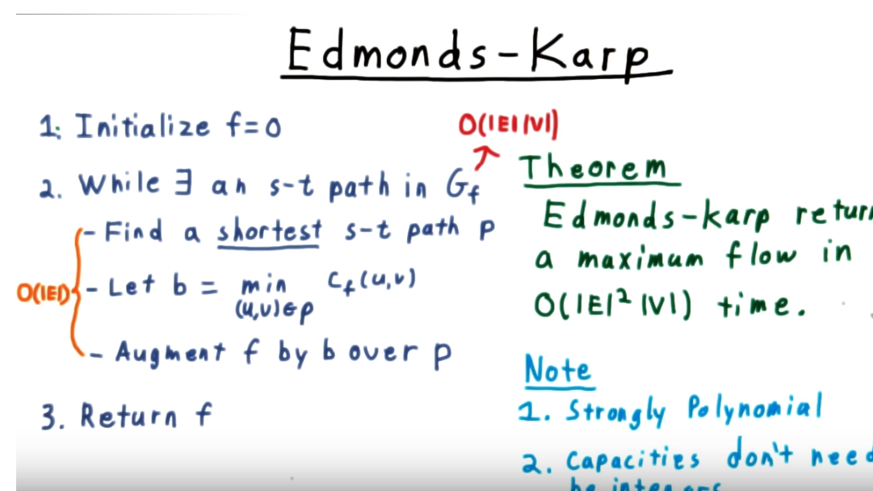

Slide 19
Time Complexity : O(E^2V).

Slide 20
Time Complexity : O(E^2V).

Slide 21
n=100 | edges | time (10^-9) | deviation (10^-9) | log edges | log time | dx/x
sp | 100 | 41 | 494 | 4.60517 | 3.713572 | 12.04878
 | 500 | 885 | 1288.46 | 6.214608 | 6.785588 | 1.455887
 | 1000 | 1157 | 1963 | 6.907755 | 7.053586 | 1.696629
 | 2000 | 3448 | 2120 | 7.600902 | 8.14555 | 0.614849
 | 2500 | 4832 | 2294 | 7.824046 | 8.483016 | 0.474752
 | 3000 | 6163 | 2222 | 8.006368 | 8.726319 | 0.360539
 | 3200 | 6055 | 2563 | 8.070906 | 8.70864 | 0.423287
 | 3500 | 6848 | 7873 | 8.160518 | 8.831712 | 1.149679
 | 4000 | 8639 | 8037 | 8.29405 | 9.064042 | 0.930316
 | 4500 | 10299 | 3468 | 8.411833 | 9.239802 | 0.336732
 | 4950 | 11985 | 7773 | 8.507143 | 9.391411 | 0.648561
n=500 | edges | time (10^-9) | deviation (10^-9) | log edges | log time | dx/x
 | 100 | 3 | 2 | 4.60517 | 1.098612 | 0.666667
 | 200 | 113 | 141 | 5.298317 | 4.727388 | 1.247788
 | 500 | 529 | 508 | 6.214608 | 6.270988 | 0.960302
 | 700 | 709 | 361 | 6.55108 | 6.563856 | 0.509168
 | 1000 | 1259 | 663 | 6.907755 | 7.138073 | 0.526608
 | 1200 | 1671 | 593 | 7.090077 | 7.421178 | 0.354877
 | 1500 | 2227 | 722 | 7.31322 | 7.708411 | 0.324203
 | 2000 | 3289 | 1179 | 7.600902 | 8.098339 | 0.358468
 | 2500 | 4489 | 1590 | 7.824046 | 8.409385 | 0.354199
 | 3000 | 6646 | 2625 | 8.006368 | 8.80177 | 0.394974
 | 3500 | 10384 | 3609 | 8.160518 | 9.248021 | 0.347554
 | 4000 | 14101 | 4387 | 8.29405 | 9.554001 | 0.311113
 | 4300 | 26000 | 12000 | 8.36637 | 10.16585 | 0.461538
 | 4500 | 32000 | 14000 | 8.411833 | 10.37349 | 0.4375
 | 4950 | 49000 | 2100 | 8.507143 | 10.79958 | 0.042857

Slide 22
For grid of the order of 480*640 using Edmond Karp algorithm –
Running time = 20 ms (order)

Slide 23
Dinic’s Flow Algorithm
In Dinic’s algorithm, we use BFS to check if more flow is possible and to construct level graph. In level graph, we assign levels to all nodes, level of a node is shortest distance (in terms of number of edges) of the node from source. Once level graph is constructed, we send multiple flows using this level graph.

Slide 24
Dinic’s Flow Algorithm
A flow is Blocking Flow if no more flow can be sent using level graph, i.e., no more s-t path exists such that path vertices have current levels 0, 1, 2… in order.

Slide 25
Dinic’s Flow Algorithm
Time Complexity : O(EV²).
Doing a BFS to construct level graph takes O(E) time.
Sending multiple more flows until a blocking flow is reached takes O(VE) time.
In each iteration, we construct new level graph and find blocking flow. It can be proved that the number of levels increase at least by one in every iteration.
So the outer loop runs at most O(V) times. Therefore overall time complexity is O(EV²).

Slide 26
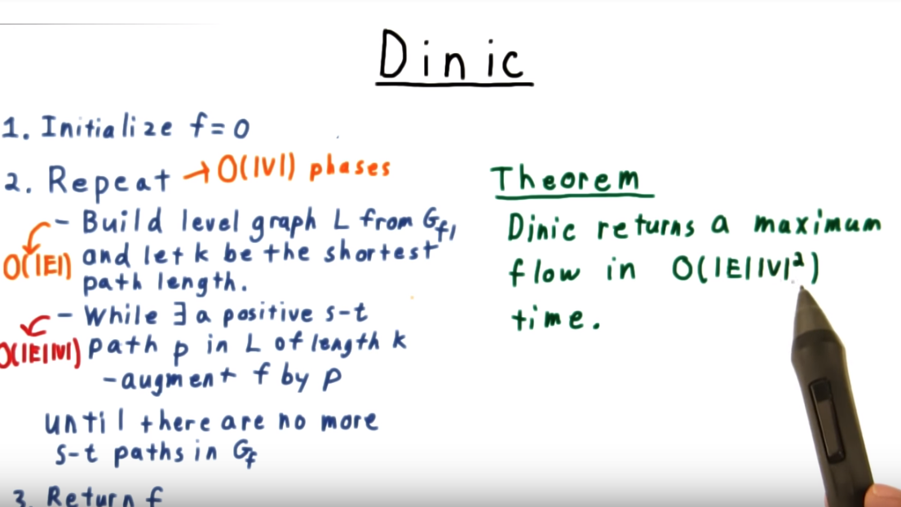

Slide 27
Time Complexity : O(EV²).

Slide 28
Time Complexity : O(EV²).

Slide 29
For grid of the order of 480*640 using Dinic Algorithm –
Running time = 2.8 - 3.2 milisec

Slide 30
Dinic’s Algorithm Implemented and run on fixed vertices and variable edges.
Vertex | Edges | LOG(Edges) | Time (10^-9 s) | Log(Time)
500 | 1000 | 3 | 877 | 2.943
 | 1500 | 3.176091 | 2492 | 3.396548
 | 2000 | 3.30103 | 4199 | 3.623146
 | 2500 | 3.39794 | 5244 | 3.719663
 | 3000 | 3.477121 | 6257 | 3.796366
 | 3500 | 3.544068 | 8238 | 3.915822
 | 3700 | 3.568202 | 9955 | 3.998041
 | 4000 | 3.60206 | 10413 | 4.017576
 | 4500 | 3.653213 | 11233 | 4.050496
vertex | edges | time (in 10^-9) | Log of edge E | Log(time)
100 | 200 | 102 | 2.301029996 | 2.0086
 | 500 | 765 | 2.698970004 | 2.883661
 | 700 | 1465 | 2.84509804 | 3.165838
 | 1000 | 2186 | 3 | 3.33965
 | 1300 | 3808 | 3.113943352 | 3.580697
 | 1500 | 3860 | 3.176091259 | 3.586587
 | 1700 | 5887 | 3.230448921 | 3.769894
 | 2000 | 6602 | 3.301029996 | 3.819676
 | 2500 | 9066 | 3.397940009 | 3.957416
 | 2700 | 12160 | 3.431363764 | 4.084934
 | 3000 | 14303 | 3.477121255 | 4.155427
 | 3500 | 20308 | 3.544068044 | 4.307667
 | 4000 | 35565 | 3.602059991 | 4.551023
 | 4500 | 48627 | 3.653212514 | 4.686877

Slide 31
Push-Relabel Algorithm
Leads to better running times, both in theory and practice.
All previous Network Flow related algorithms are related to augmentation.
Drawback of augmentation-based schemes:
Each augmentation takes O(n) time. Multiple augmentations may partially share paths, but it’s not exploited by algorithms.

Slide 32
Preflow Basics
Preflow algorithm allow temporary imbalance (excess) at nodes, and work towards feasibility.
Formally, a preflow is a function p : E → R that satisfies capacity constraints and
∑_{j} p_{ji} - ∑_{j} p_{ij} ≥ 0, for all i ∉ {s, t}
i.e. Incoming flow – Outgoing flow ≥ 0
For a given preflow, the excess at a node i is defined as e(i) = ∑p_{ji} - ∑_{j} p_{ij}
Because no edge leaves t, e(t) ≥ 0. Node s is the only one with e(s) ≤ 0.

Slide 33
Distance Labels and Preflow
We call a node active if it has +ve excess (e(v)>0). Source and Sink are never active.
Preflow algorithms repeatedly select an active mode and push
it’s flow to neighbors which are close to sink.
Distance Labeling λ assigns to each node v an integer λ(v).
Initially, λ(s) = n = ⏐V ⏐, λ(v) = 0 for all other nodes v.
If edge ij is available for a push then λ(i) ≤ λ(j) + 1. So whenever p_{ij} < c_{ij} or p_{ji} > 0, we have λ(i) ≤ λ(j) + 1. Here p_{ij} or p_{ji ``}is preflow.
Call an edge ij admissible if λ(i) = λ(j) + 1.

Slide 34
Generic Preflow-Push
Initialize:
Set p = 0.
For all (s,j) ∈ E, p_{sj} = c_{sj}.
Set λ(s) = n = ⏐V ⏐.
Push-Relabel (i):
If there is an admissible edge (i,j) then Push min {e(i), c_{f}(i,j)} units on (i,j).
Else λ(i) = 1 + min {λ(j)}, c_{f}(i,j) > 0. Here (i,j) ∈ E.
Generic Preflow-Push:
Initialize.
While exists an active node do Select an active node i Push-Relabel (i).

Slide 35
Example
Step 1: Initial Diagram
Step 2: Initialize the preflow & labeling
e=4
λ=0
a
4,4
5,0
4
5
λ=4
3,0
e=0
3
λ=0
2
1
2,2 1,0
b
λ=0
e=2
Step 4: Relabel b : λ=1
Push on bt: p_{bt}=2, e=0
e=0
λ=1
Step 3: Relabel a : λ=1
Push on at: p_{at}=4, e=0
e=0
λ=1
4,4
5,4
4,4
5,4
λ=4
3,0
e=4
λ=4
3,0
e=5
λ=0
λ=0
2,2
1,0
2,2
1,1
λ=0
λ=1
e=2
e=1

Slide 36
Example
Step 5: Relabel b : λ=2
Push on ba: p_{ba}=1, e=0
e=1
λ=1
a
4,4
5,4
λ=4
3,1
e=5
λ=0
2,2
1,1
λ=2
b
e=0
e=0
λ=1
Step 6: Relabel a : λ=1
Push on at: p_{at}=4, e=0
λ=4
4,4
5,5
3,1
e=6
λ=0
2,2
1,1
λ=2
e=0

Slide 37
paper: http://www.csd.uwo.ca/~yuri/Papers/pami04.pdf
Kolmogorov thesis for more detailed description (chapter 5):
http://pub.ist.ac.at/~vnk/papers/thesis.pdf
We have to implement the algorithm suggested in the research paper and reach the execution time values as stated in the research paper and validate it.

Slide 38
Thank You

